Slide 1
Data Transformation
DSPG

Slide 2

Data Transformation
Data transformation refers to the mapping of dataset field values from a provided format into an expected or more useful format.

Slide 3
Reading in Data
Tidy data expects each variable is in a column and each observation/case/participant is in its own row (wide format)
data1 <- read.csv(“file path”)
“franchise.csv”
data2 <- read.csv(“file path”)
“franchise2.csv”

Slide 4
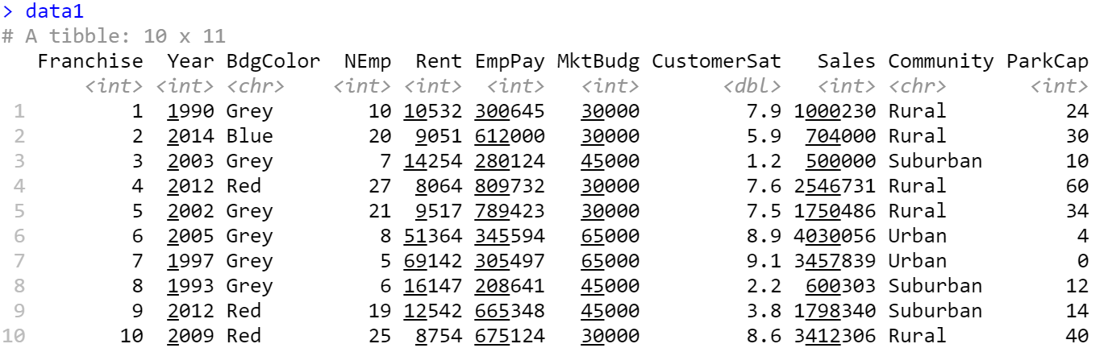
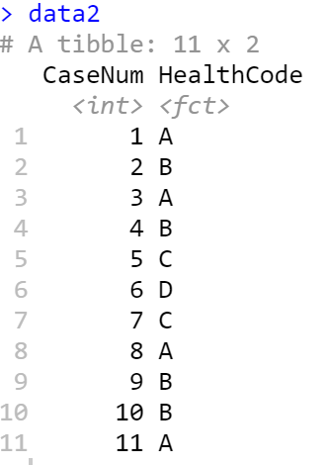
Reading in Data

Slide 5
Aggregate Cases

Slide 6
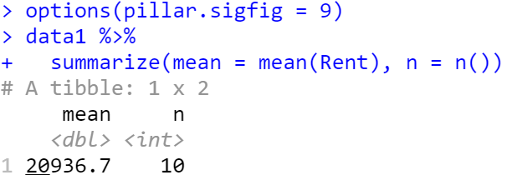
Aggregate Cases with summarize()
The summarize()function returns an aggregated value

Slide 7
Group Cases

Slide 8
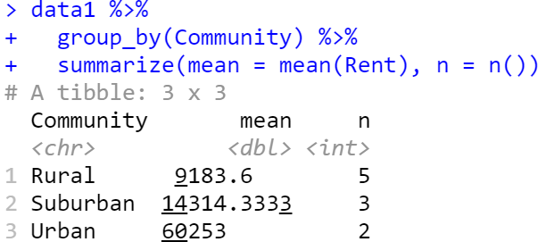
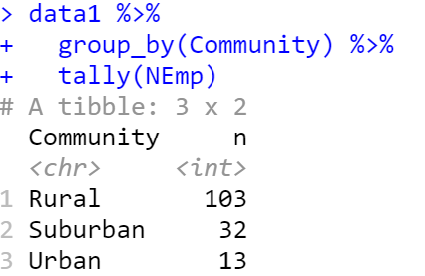
Group Cases with group_by()
Aggregations can be made by group using group_by() with summarize()
Use ungroup() to ungroup groupings

Slide 9
Manipulate Cases

Slide 10
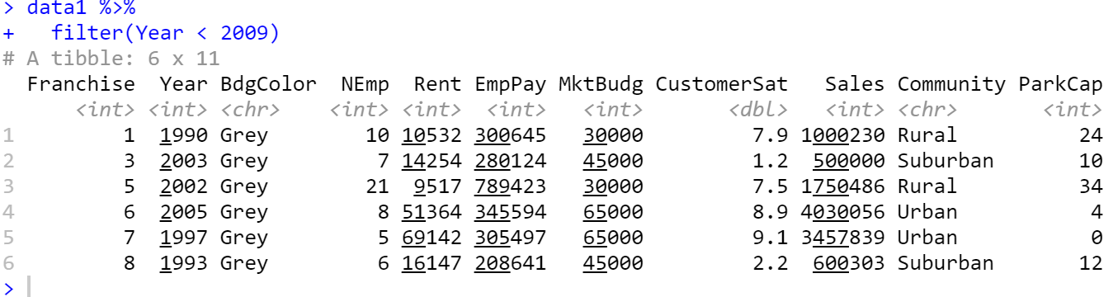
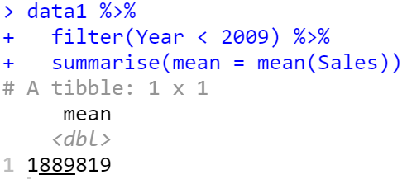
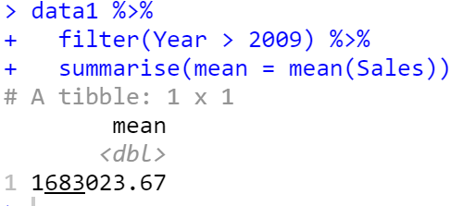
Extract Cases with filter()
Filters rows based on logical criteria of the columns (i.e., variables)

Slide 11
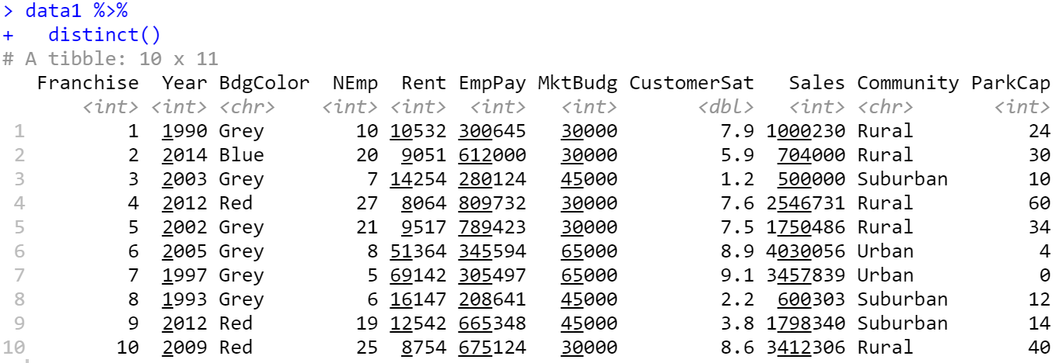
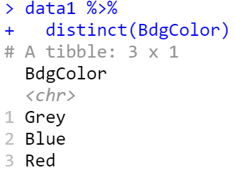
Extract Cases with distinct()
Removes rows with duplicate values.
Notes:
No duplicate rows

Slide 12
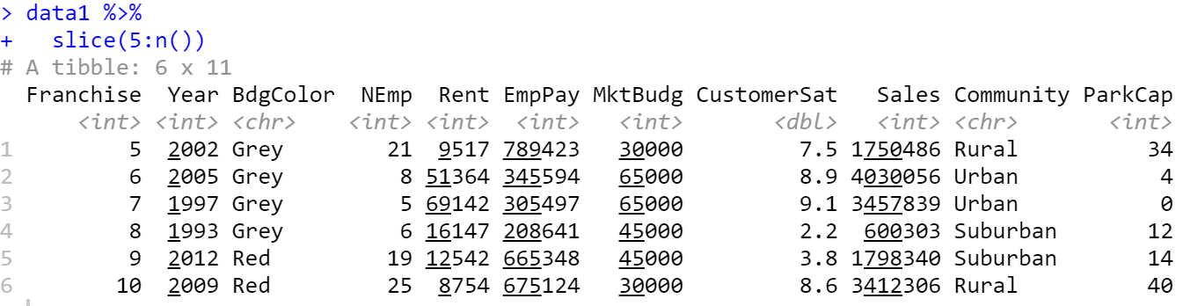
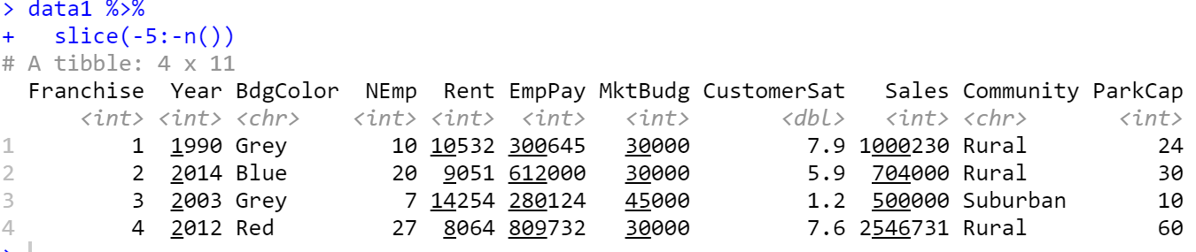
Extract Cases with slice()
Selects rows based on their position.
> data1 %>%
+ filter(between(row_number(), 5, n()))
> data1 %>%
+ filter(between(row_number(), 1, 4))

Slide 13
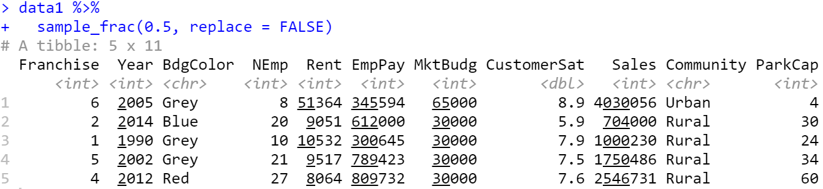
Extract Cases with sample_frac()
Selects random fraction of rows to form subsample.

Slide 14
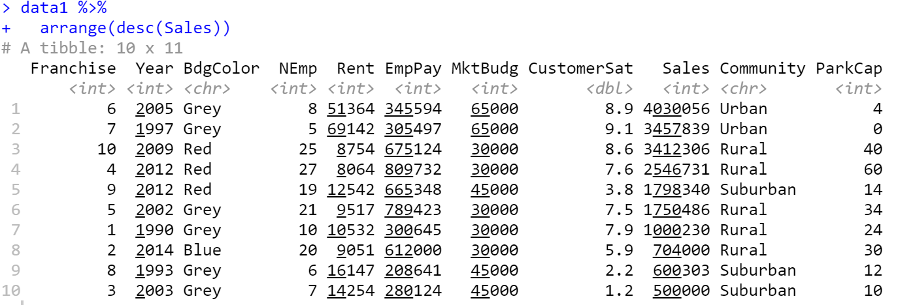
Arrange Cases with arrange()
Order rows by values of variables.
Use desc()to order from high to low.

Slide 15
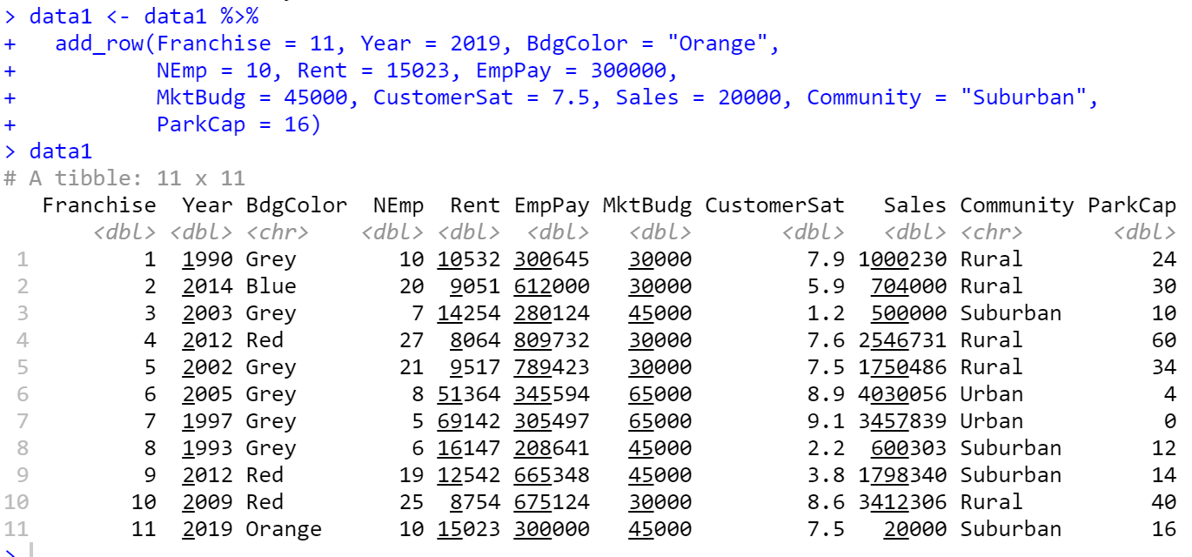
Add Cases with add_row()
Add a new case to the dataset.

Slide 16
Manipulate Variables

Slide 17
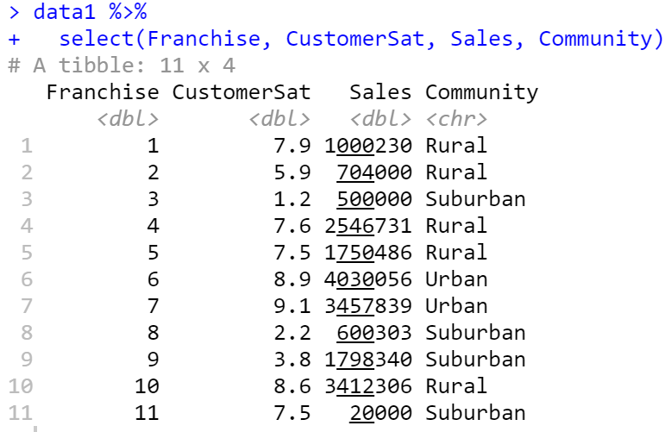
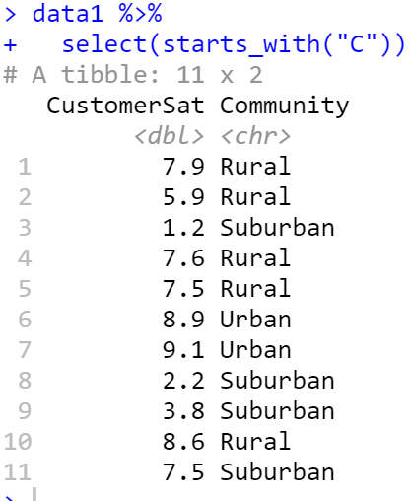
Extract Variables with select()
Filters columns (i.e., variables) that meet logical criteria
Helpers with select()
starts_with(match)
ends_with(match)
contains(match)
matches(match)
num_range(prefix, range)
one_of(…)

Slide 18
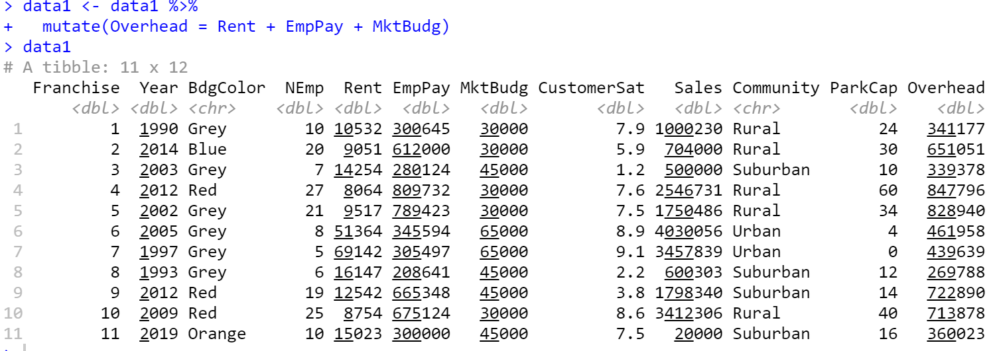
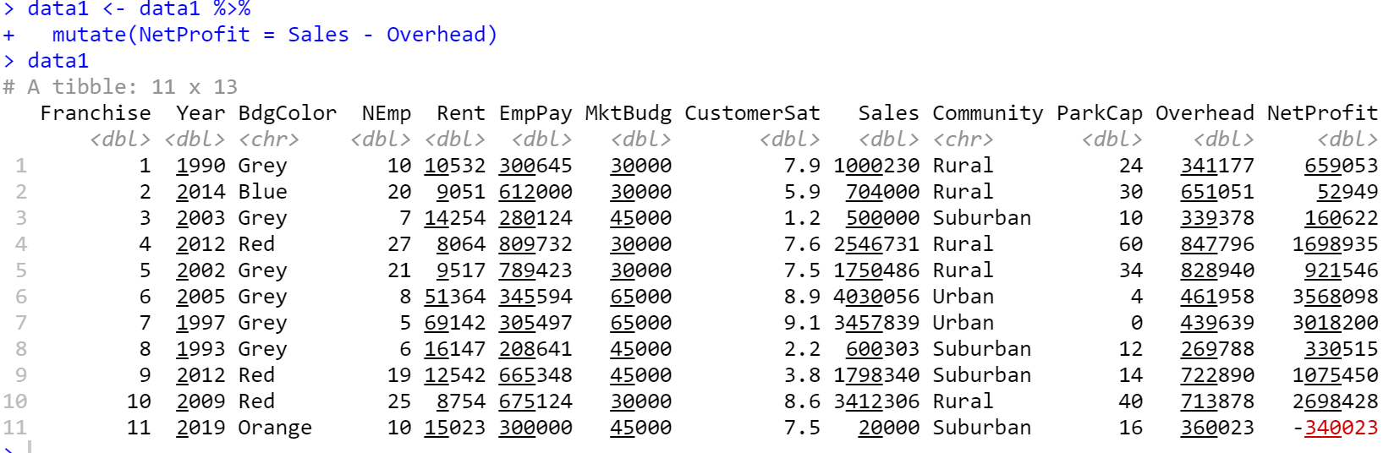
Make New Variables with mutate()
Computes new columns (i.e., variables)

Slide 19
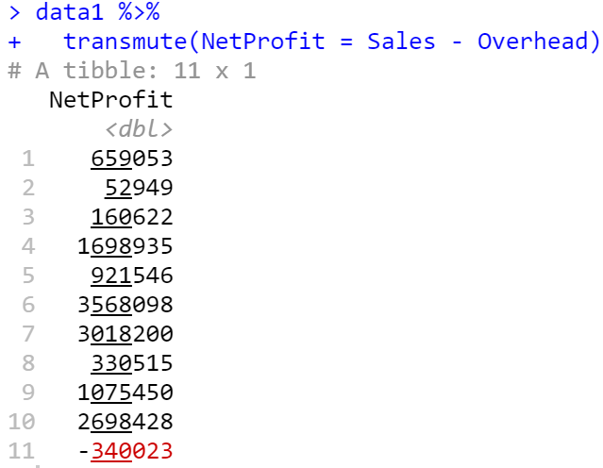
Make New Variables with transmute()
Computes new columns (i.e., variables) and drops other variables

Slide 20
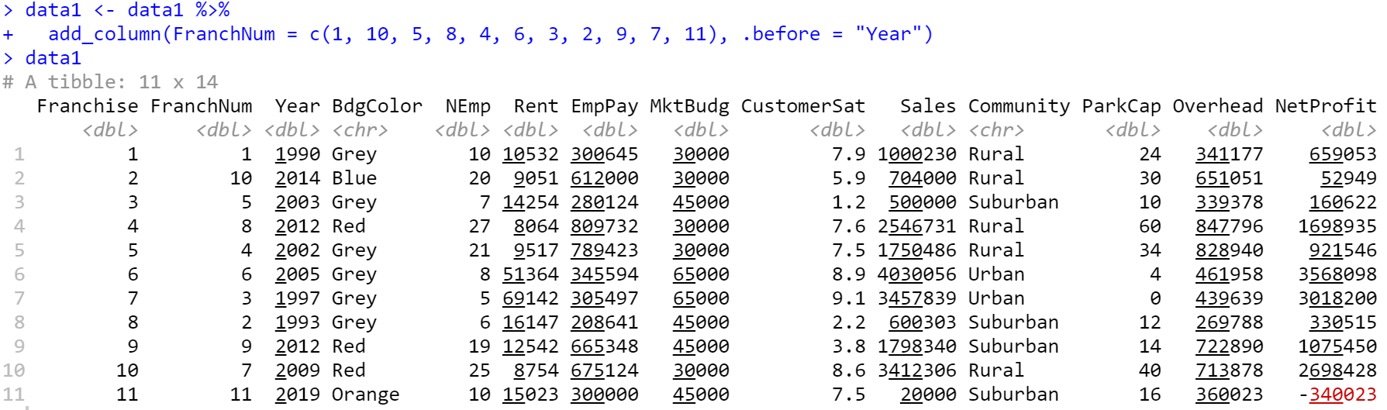
Make New Variables with add_column()
Adds new column.

Slide 21
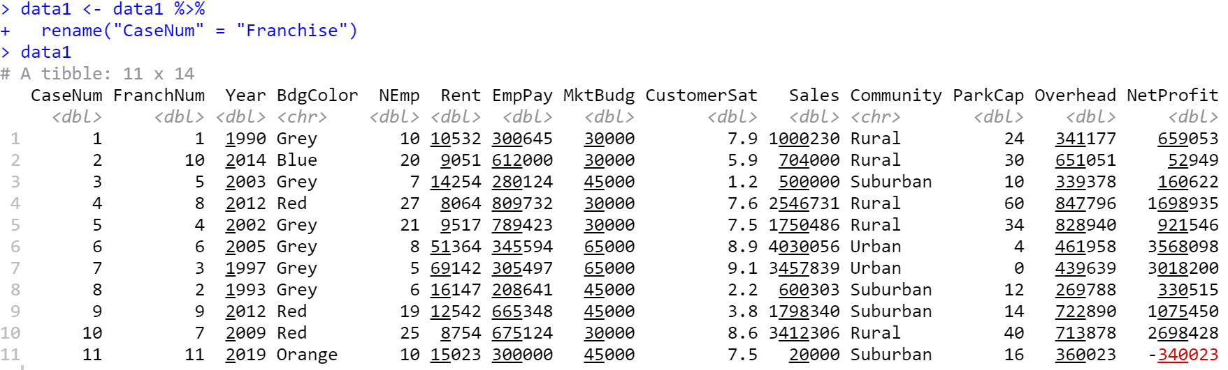
Rename Variables with rename()
Renames a column

Slide 22
Combining Data

Slide 23
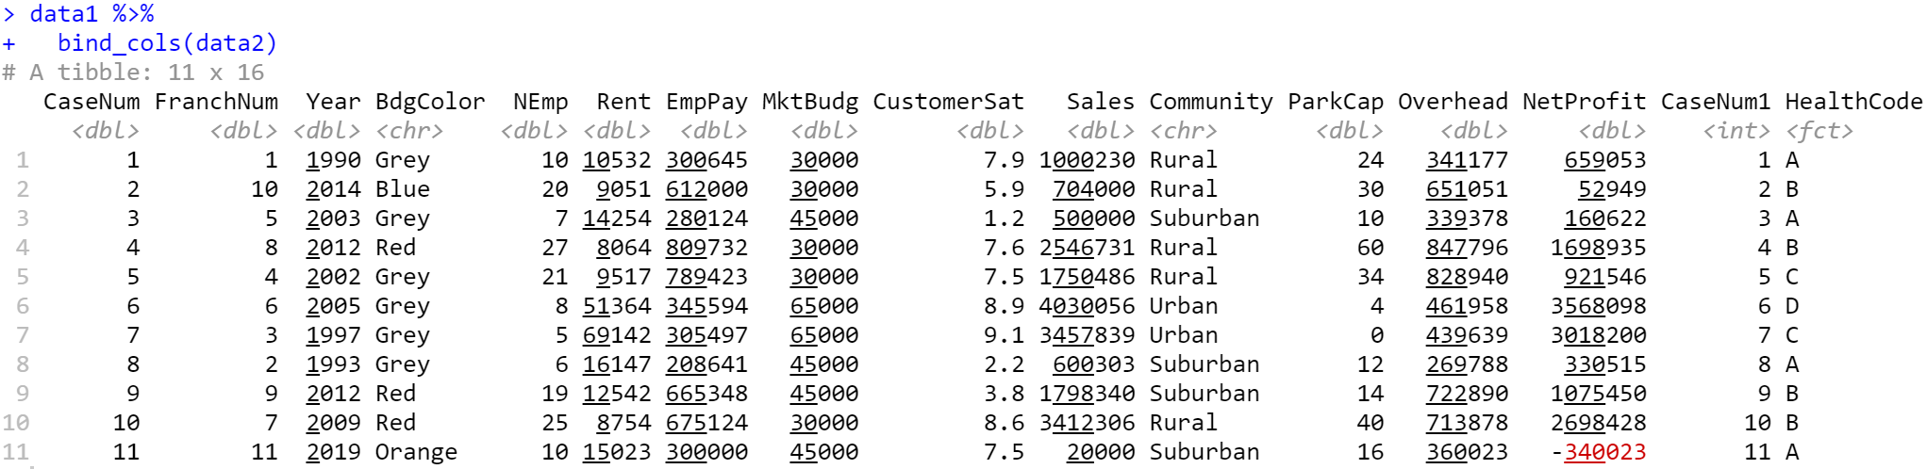
Combine Tables with bind_cols()
Combine tables next to each other as they are.

Slide 24
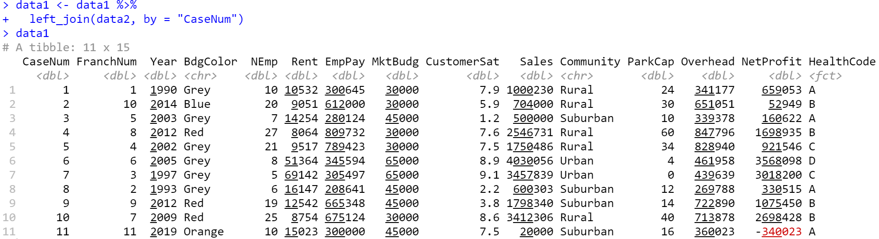
Combine Tables with left_join()
Combine tables based on an index variable that is common to both tables, joining values from y to x
Other join functions
right_join(): Join matching values from x to y
inner_join(): Join data but retain only rows with matches
full_join(): Join data and retain all values and rows

Slide 25
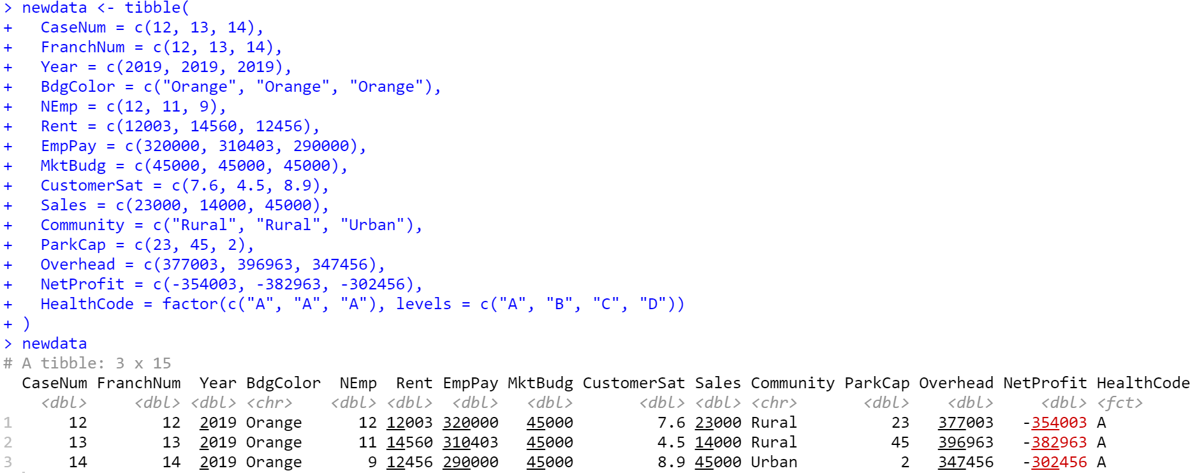
Combine New Cases with bind_rows()
Combine new rows (cases) to a table

Slide 26
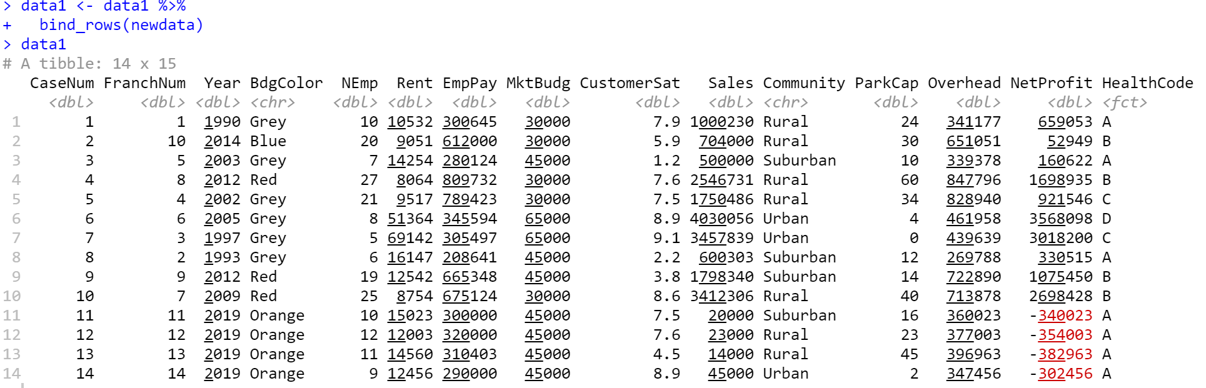
Combine New Cases with bind_rows()
Combine new rows (cases) to a table

Slide 27
Data Smoothing &
Interpolation

Slide 28
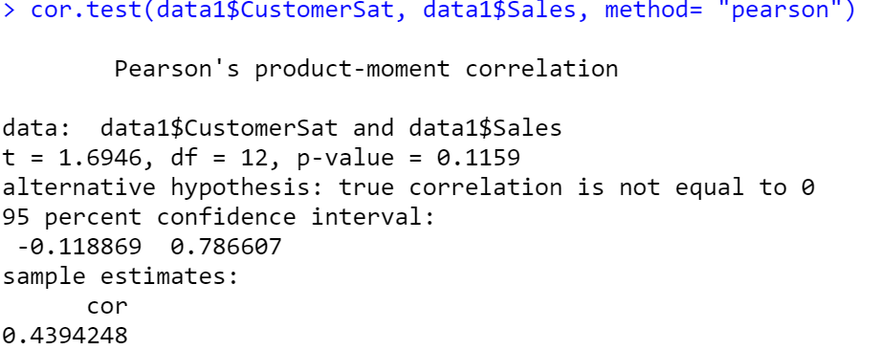
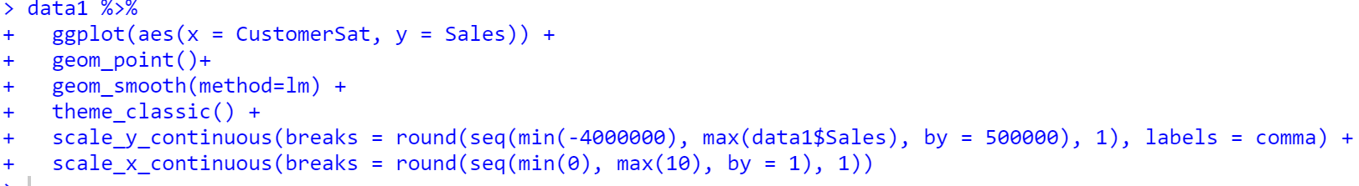
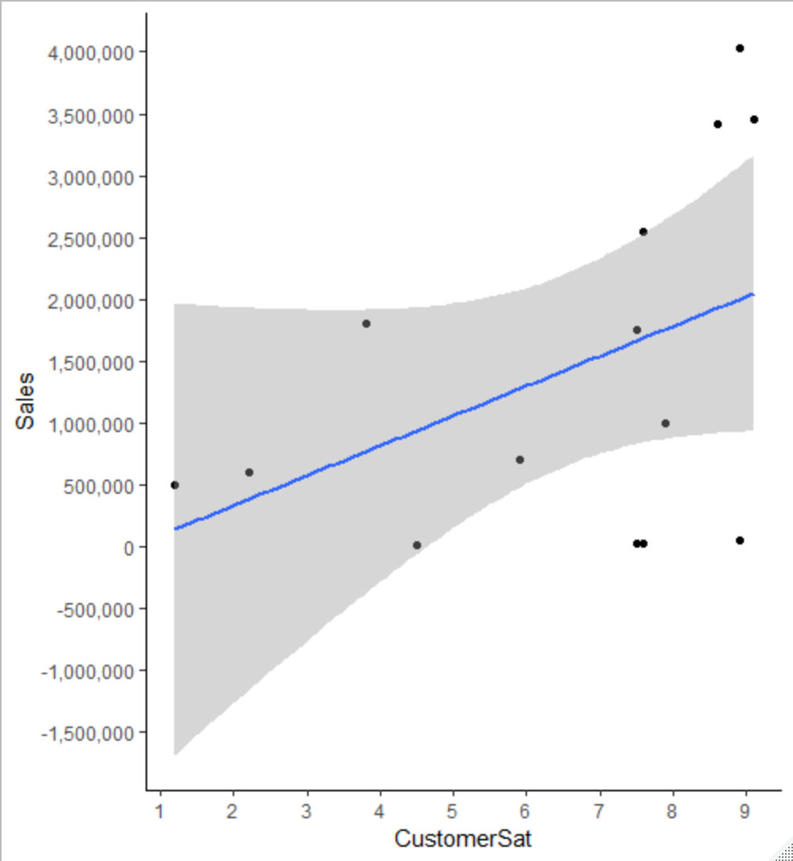
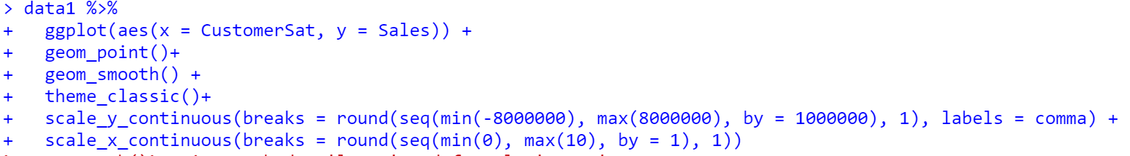
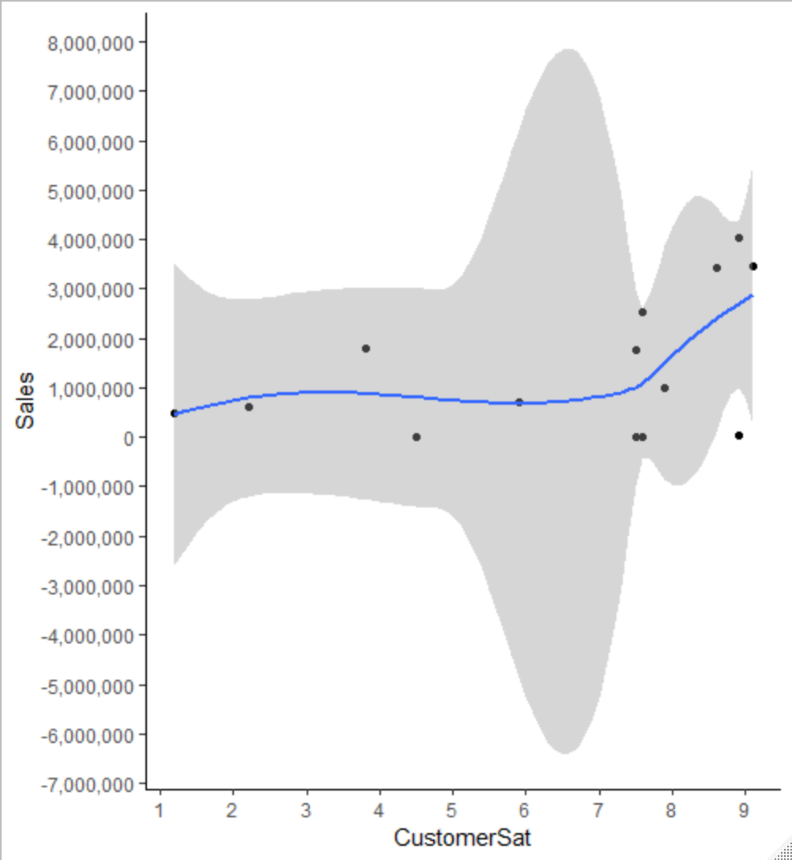
Smoothing Data
Represent data through smoothing
Notes:
data1 %>%
ggplot(aes(x = CustomerSat, y = Sales)) +
geom_point()+
geom_smooth(method=lm) +
theme_classic()+
scale_y_continuous(breaks = pretty(data1$Sales, n = 10), labels = comma) +
scale_x_continuous(breaks = pretty(data1$CustomerSat, n = 10))

Slide 29
Smoothing Data
Represent data through smoothing
Notes:
The fitted function returns the y-hat values associated with the data used to fit the model. The predict function returns predictions for a new set of predictor variables. If you don't specify a new set of predictor variables then it will use the original data by default giving the same results as fitted for some models, but if you want to predict for a new set of values then you need predict. The predict function often also has options for which type of prediction to return, the linear predictor, the prediction transformed to the response scale, the most likely category, the contribution of each term in the model, etc.

Slide 30
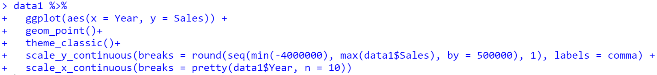
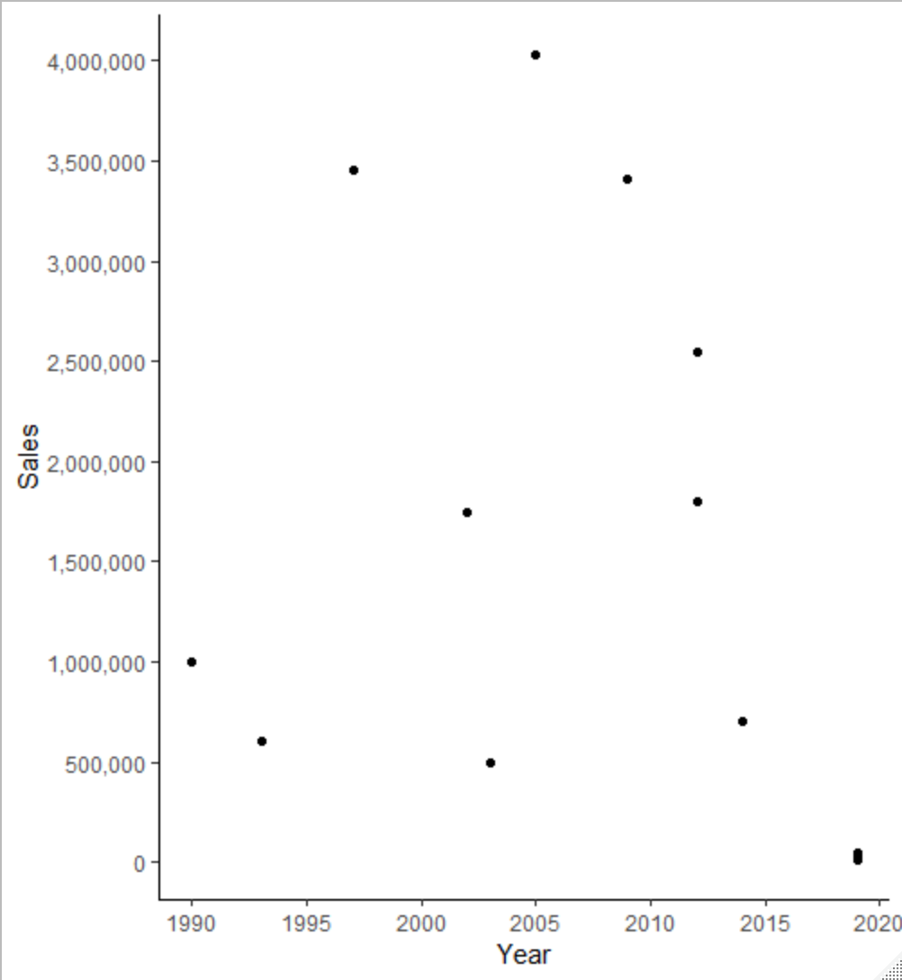
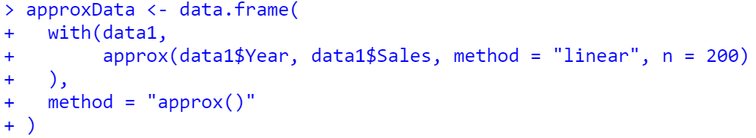
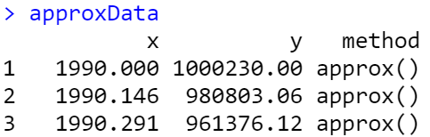
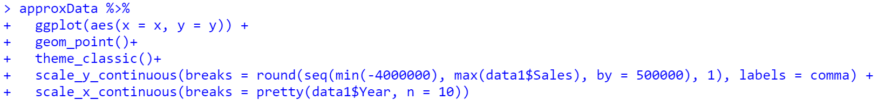
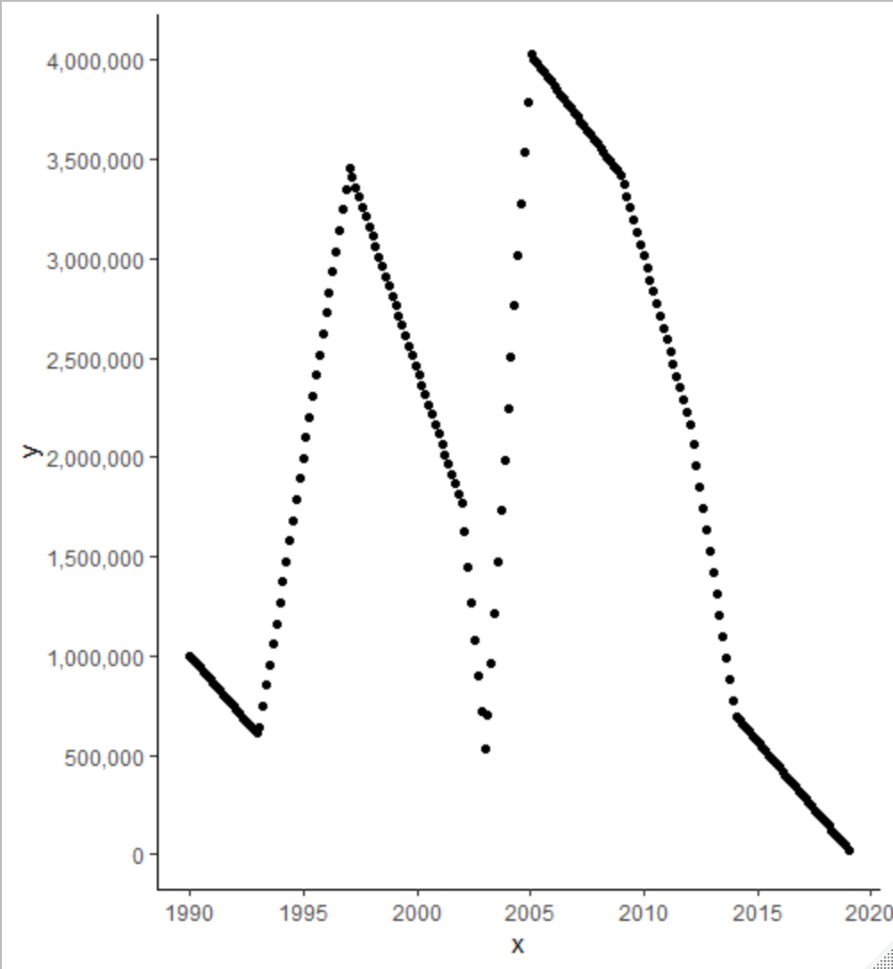
Interpolate Data with approx()
Using existing data, interpolate points for unobserved values

